Slide 1
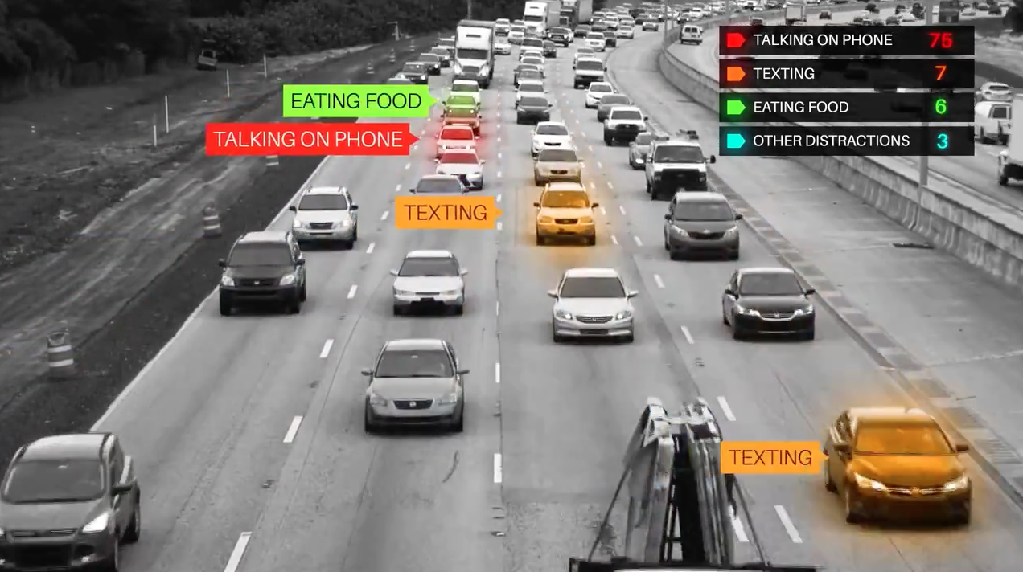
Distracted Driver Detection
Kaggle Competition sponsored by State Farm
Image via adweek

Slide 2
Distracted Driving - The Dangers
3,477 number of people killed 2015
~9 people killed every day
391,000 injured
15% of injury crashes - (10% of fatal crashes)
481,000 passenger vehicles driven by people using handheld 391,000 injured
at “a typical daylight moment” (2016)
9% of all drivers 15-19 years old involved in fatal crashes
largest proportion
NHTSA

Slide 3
Distracted Driving - Prevention
“State Farm hopes to improve these alarming statistics, and better insure their customers, by testing whether dashboard cameras can automatically detect drivers engaging in distracted behaviors.”
Event Data Recorder – “continuously records information about the vehicle”
never more than thirty seconds of data
informally referred to as a car’s “black box”
Dashboard cameras possibly the next iteration
alternative may include steering-wheel sensors
not as undeniable as images/video

Slide 4
Distracted Driving - Prevention; because quite frankly…
Analogy:
What is airplane mode?
stuff
Okay that’s great, so why can’t I use my phone?
Most likely, the consequence of doing so is not going to be significant
However, there is then a very small chance that I might cause this plane to crash
“I don’t know, so I won’t take that risk”
But you still always see at least a few people on their phones… even though the plane could crash…

Slide 5
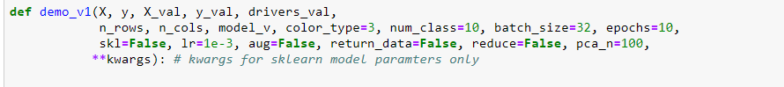
Distracted Driving - Supervised Learning, structure

Slide 6
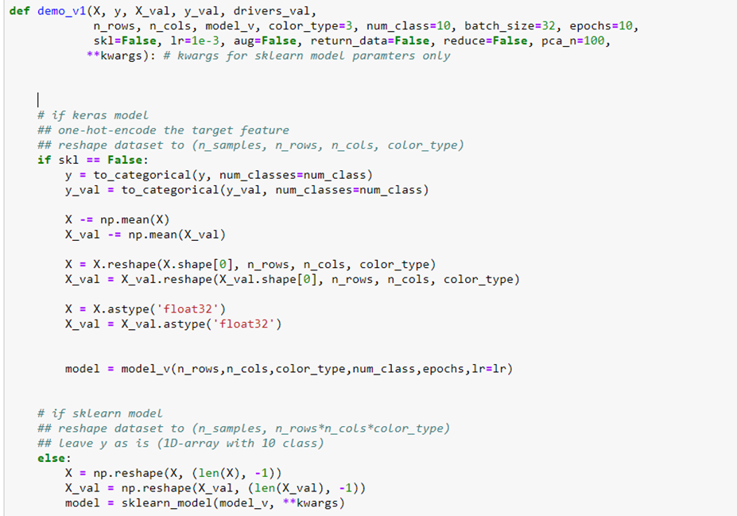
Distracted Driving - Supervised Learning, structure

Slide 7
Distracted Driving - Supervised Learning, structure

Slide 8

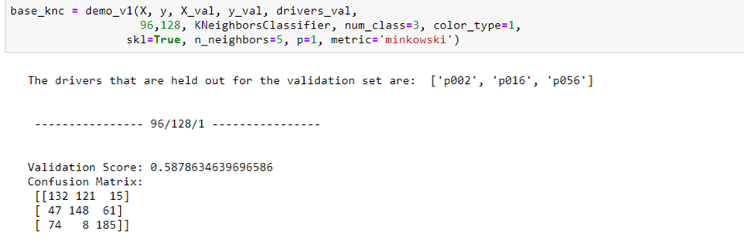
Distracted Driving - Supervised Learning, sklearn

Slide 9
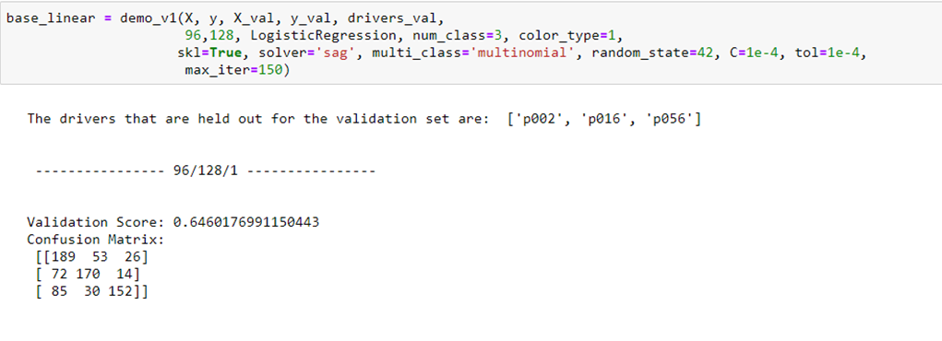
Distracted Driving - Supervised Learning, sklearn

Slide 10
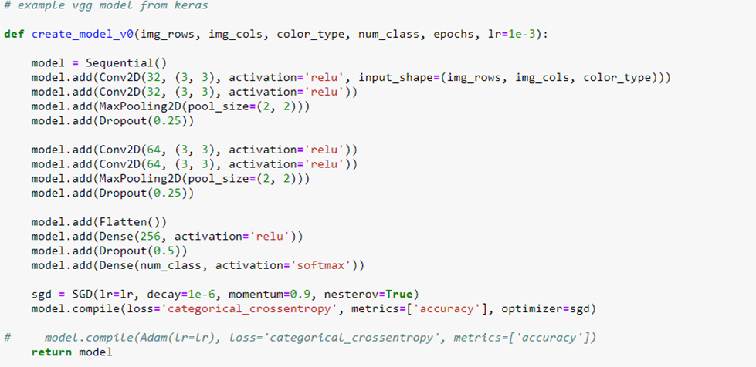
Distracted Driving - Supervised Learning, keras

Slide 11
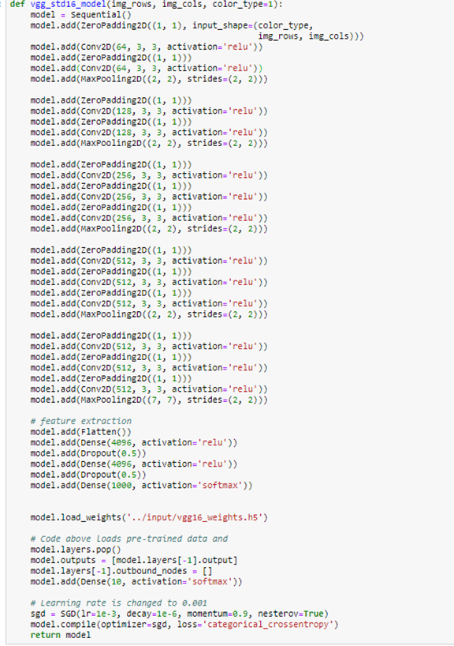
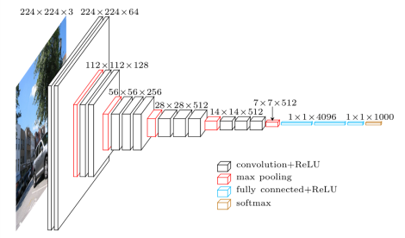
Distracted Driving - Supervised Learning, keras
Convolutional Neural Network

Slide 12
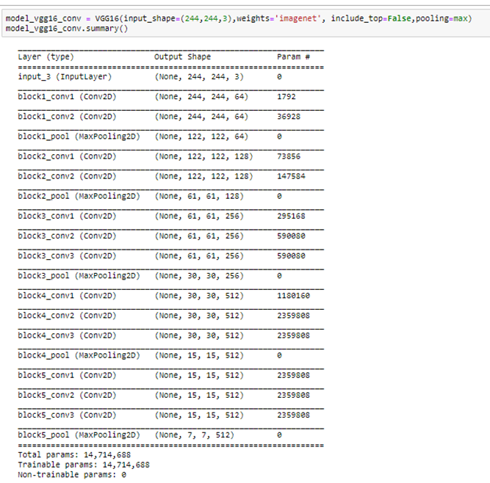
Distracted Driving - Supervised Learning, keras
Convolutional Neural Network

Slide 13
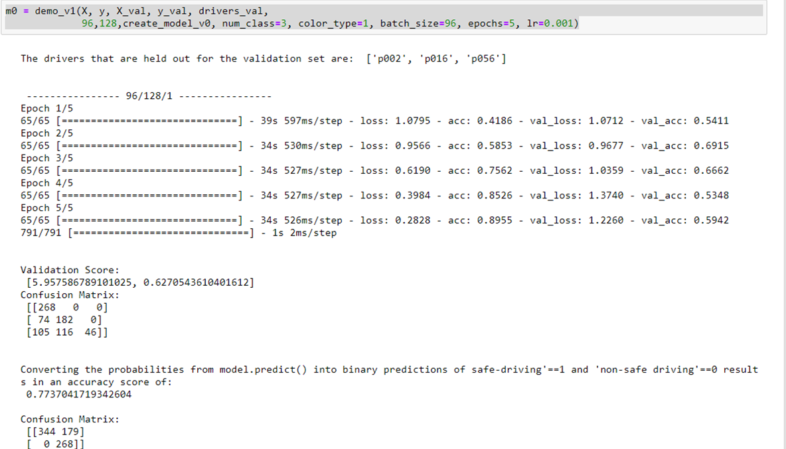
Distracted Driving - Supervised Learning, keras

Slide 14
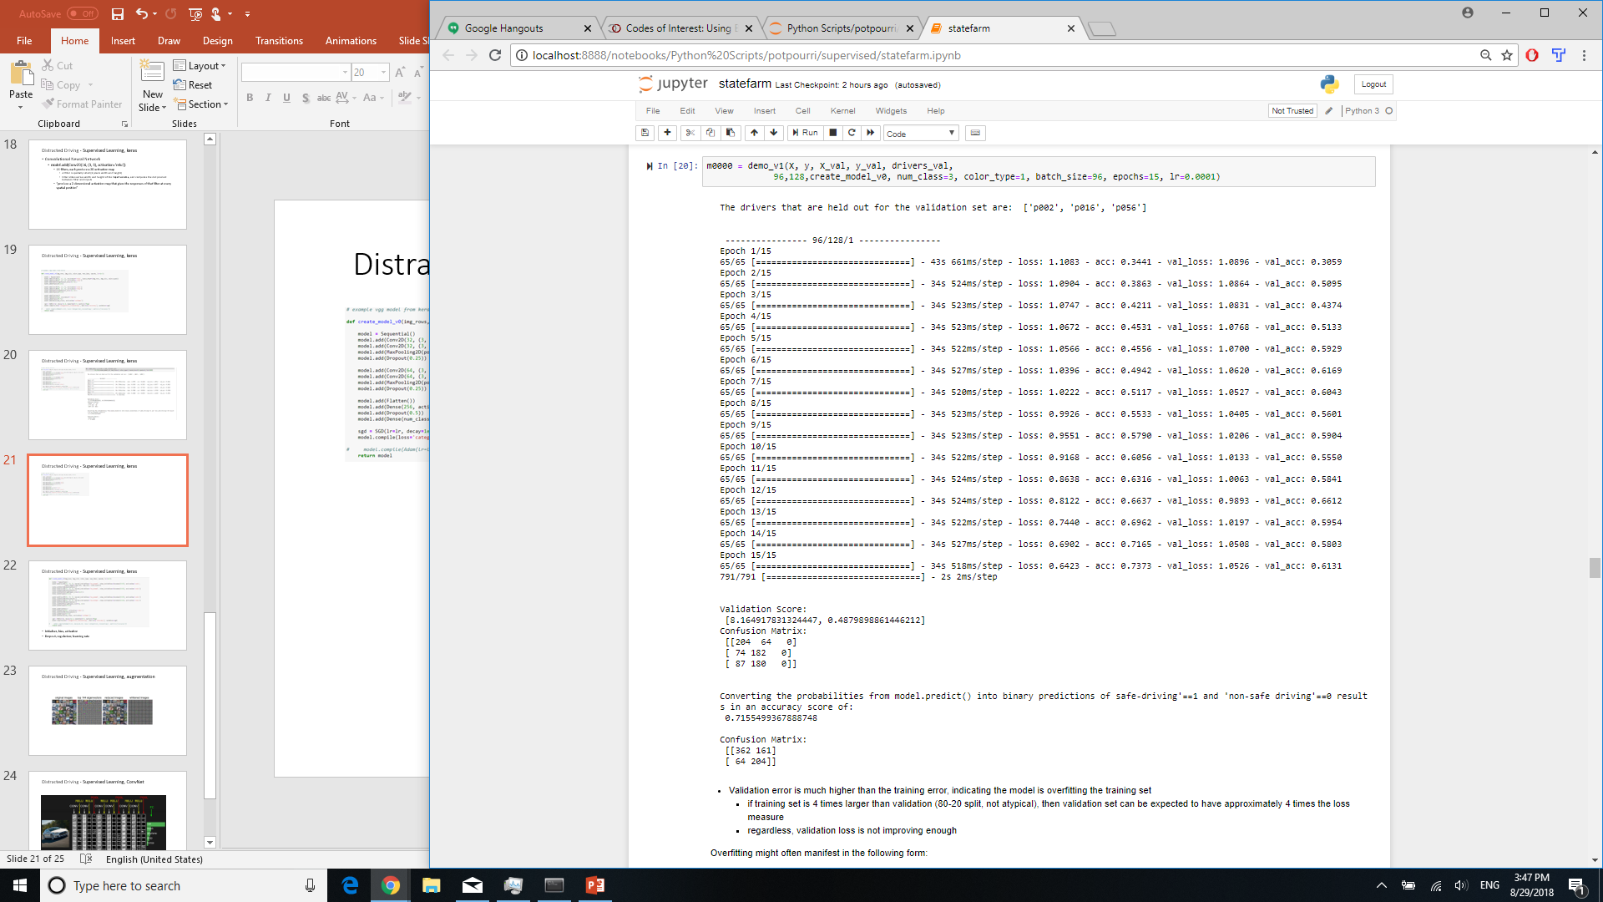
Distracted Driving - Supervised Learning, keras

Slide 15
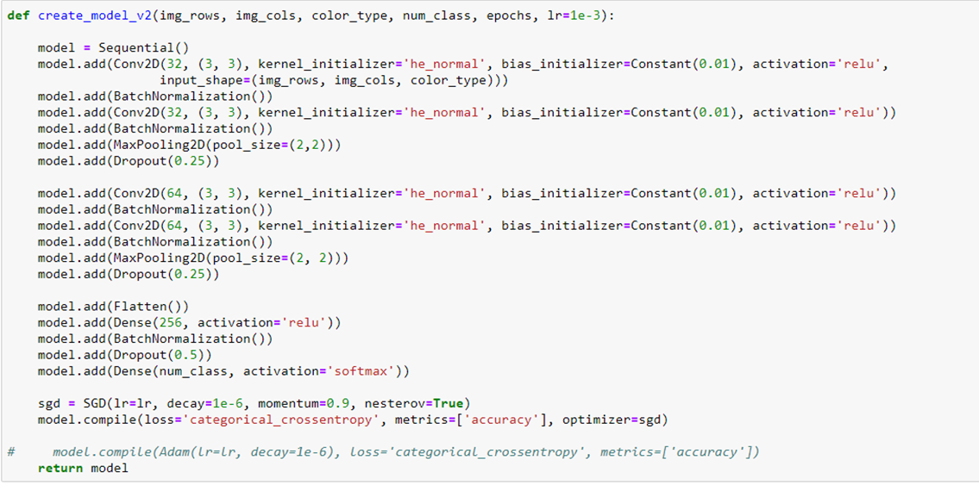
Distracted Driving - Supervised Learning, keras
Initializer, bias, activation
Dropout, regularizer, learning rate

Slide 16
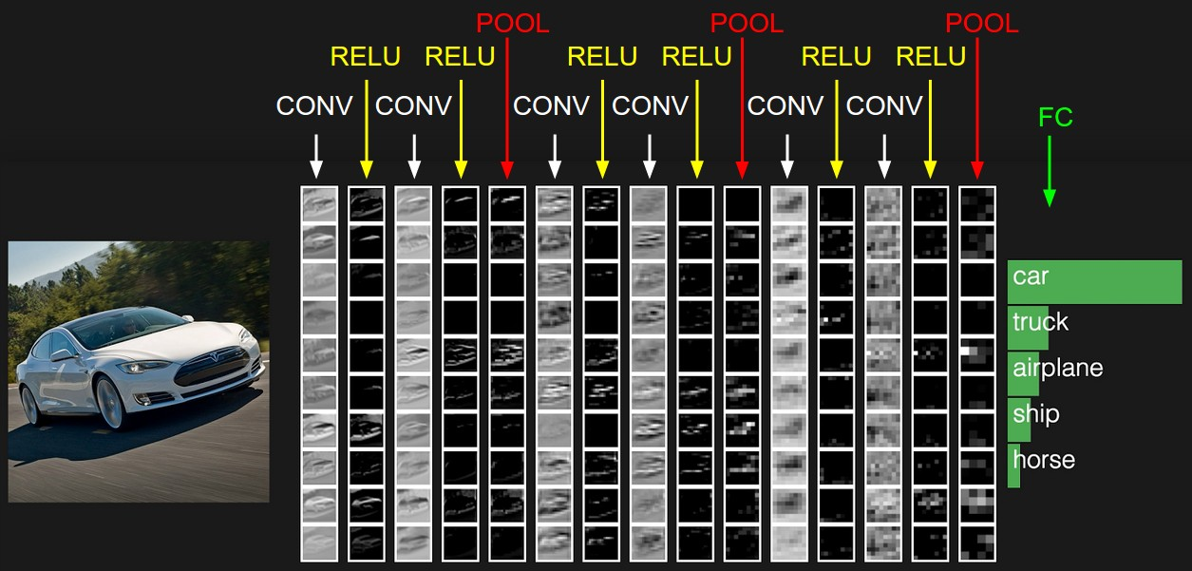
Distracted Driving - Supervised Learning, ConvNet

Slide 17
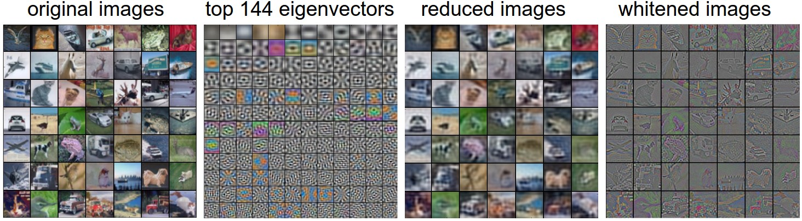
Distracted Driving - Supervised Learning, augmentation

Slide 18
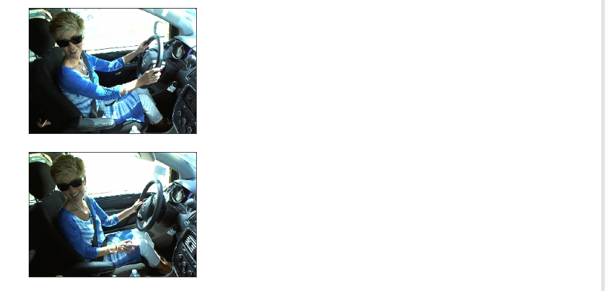
Distracted Driving - Supervised Learning, labeling

